Slide 1

Solar Powered Electric Vehicle Charger
Team of :-
Kshitiz (1840176)
Mahesh Yadav (1840166)
Gautam Kumar (1840172)
Shivotkarsh Raj (1840179)
Faculty Advisor :-
Dr Manmohan Singh (Associate Professor, Dept. of Electrical & Instrumentation Engineering)
Project Co-Ordinator :-
Dr. Charanjiv Gupta (Associate Professor, Dept. of Electrical & Instrumentation Engineering)

Slide 2
CONTENTS
Stage 1
1.1 Introduction to Solar PV Invertor
1.2 Construction of Solar PV Invertor
1.2.1 Circuit Diagram
1.2.2 Simulation
Stage 2
2.1 Introduction to Solar PV Invertor for EVs
2.2 Construction of Solar PV Invertor for EVs
2.2.1 Circuit Diagram
2.2.2 Simulation
Stage 3
3.1 Solar PV Batteries and Charging
3.2 Design of Batteries and Charging Station
3.3 Solar Tracker
3.4 Circuit Design & Simulation of Solar Tracker
3.5 Advantages and Disadvantages
3.6 Future Scope

Slide 3

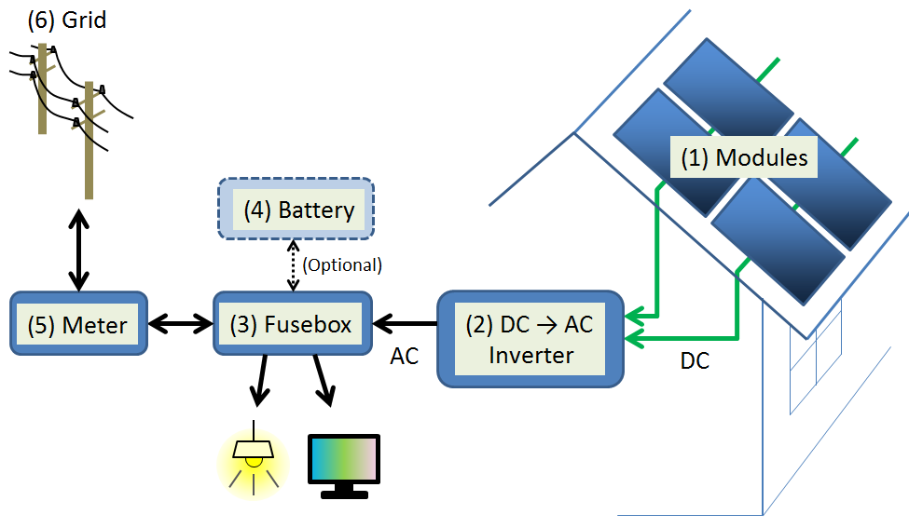
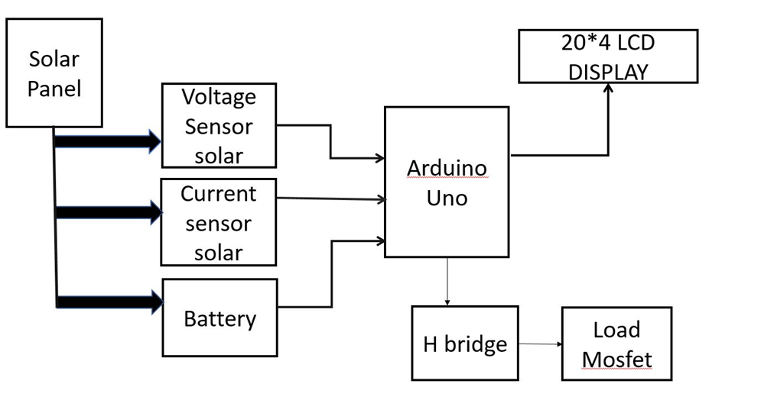
STAGE-1
PV Solar Invertor
A solar inverter or PV inverter, is a type of electrical converter which converts the variable direct current (DC) output of a photovoltaic (PV) solar panel into a utility frequency alternating current (AC) that can be fed into a commercial electrical grid or used by a local, off-grid electrical network or for the purpose of green fuel in EVs.
Block Diagram PV Solar Invertor

Slide 4
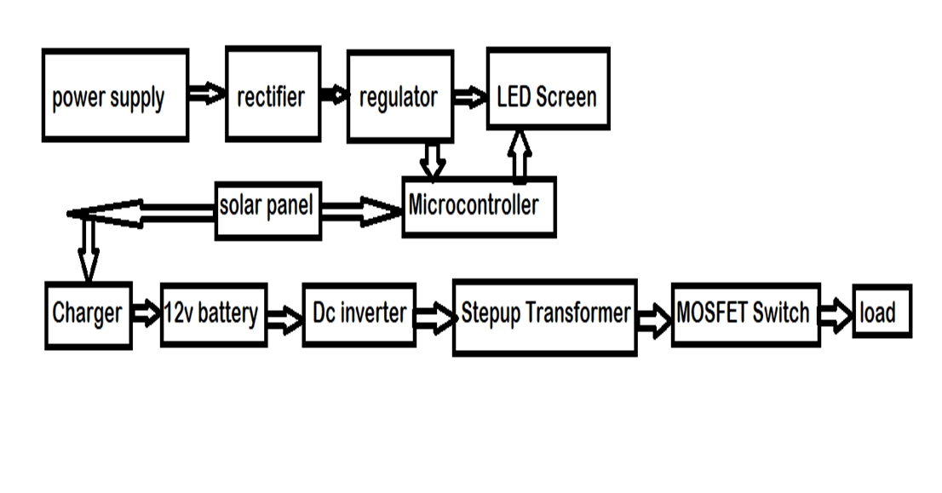
Circuit Power Flow Diagram
The Circuit diagram of Solar PV Inverter is such that the Solar Panels are connected in series with the Microcontroller ATMega328 to get maximum voltage or Power from the Sun.
Components Used in Solar PV Invertor
Solar panel – 12V
LM317 voltage regulator
DC battery- 12V
IC CD4047
Diode – 1n4007
Capacitor – 0.1uf , 0.01uf, 2200uf, 22uf
Schottky diode – 3A, 50V
Resistors – 220, 680,820
Variable Resistor – 2k,
Transformer - 230 v , 2A, 50hz
Switch SPST
LED
N- channel MOSFET –IRF540
Connecting wires

Slide 5
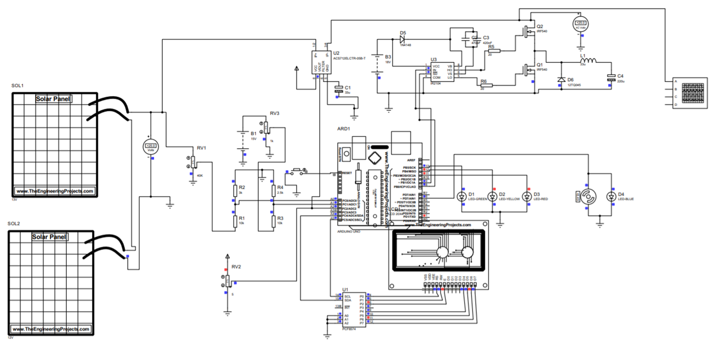
Circuit Diagram of Solar Invertor

Slide 6
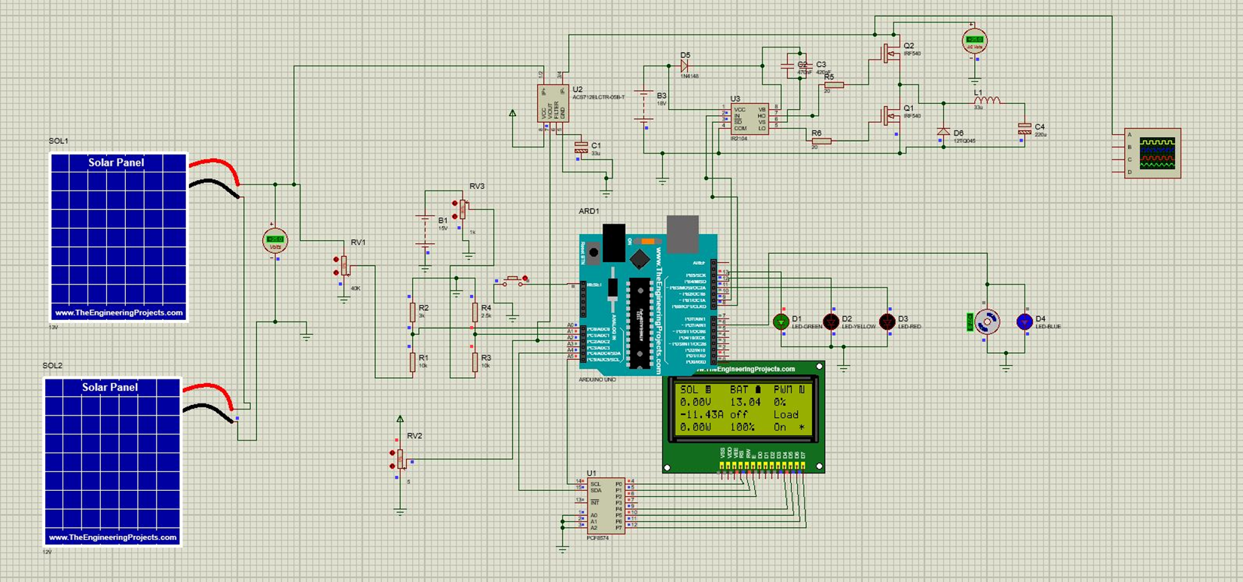
Simulation PV Solar Invertor

Slide 7
STAGE-2
Solar Inverter in EVs
The motivation behind this project to operate EV on 100% clean energy. As we know we still use electricity produced from burning coal. Thus, we can’t say we that we are operating EV on clean energy.
2. We have divided this protect in two stages:
a) The 1st stage consists of a mini model of solar battery charging ising
Arduino UNO.
b) And 2nd stage consist the Simulink based simulation of solar pv and
charger
The system works in an integrated way to optimize the energy use from
the grid. The system will take the power from solar arrays and directly
charge the EV when solar energy is available.

Slide 8
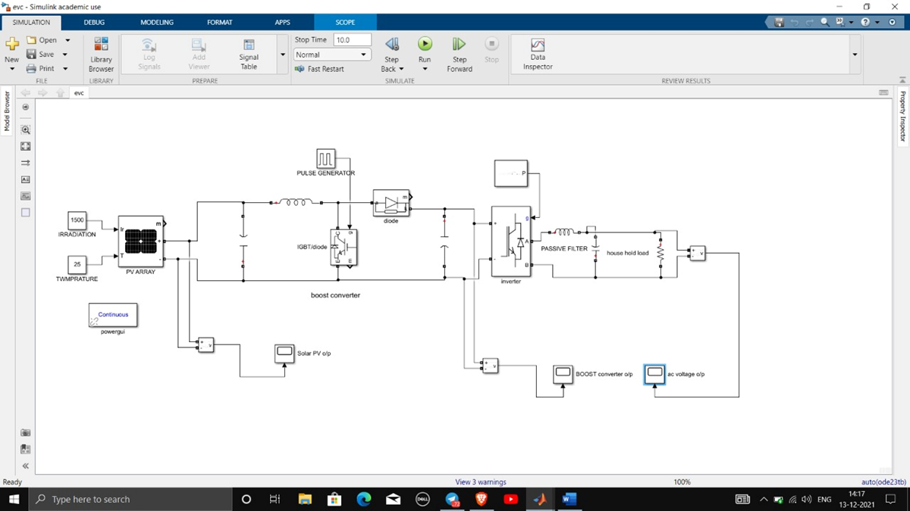
MATLAB SIMULATION AND CIRCUIT

Slide 9
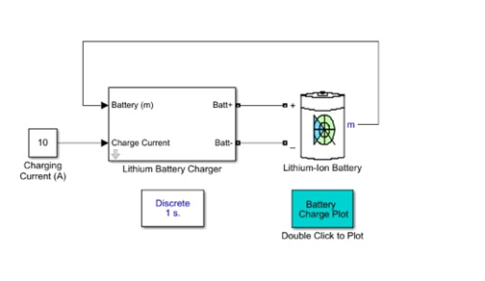
BATTERY CHARGING CIRCUIT

Slide 10
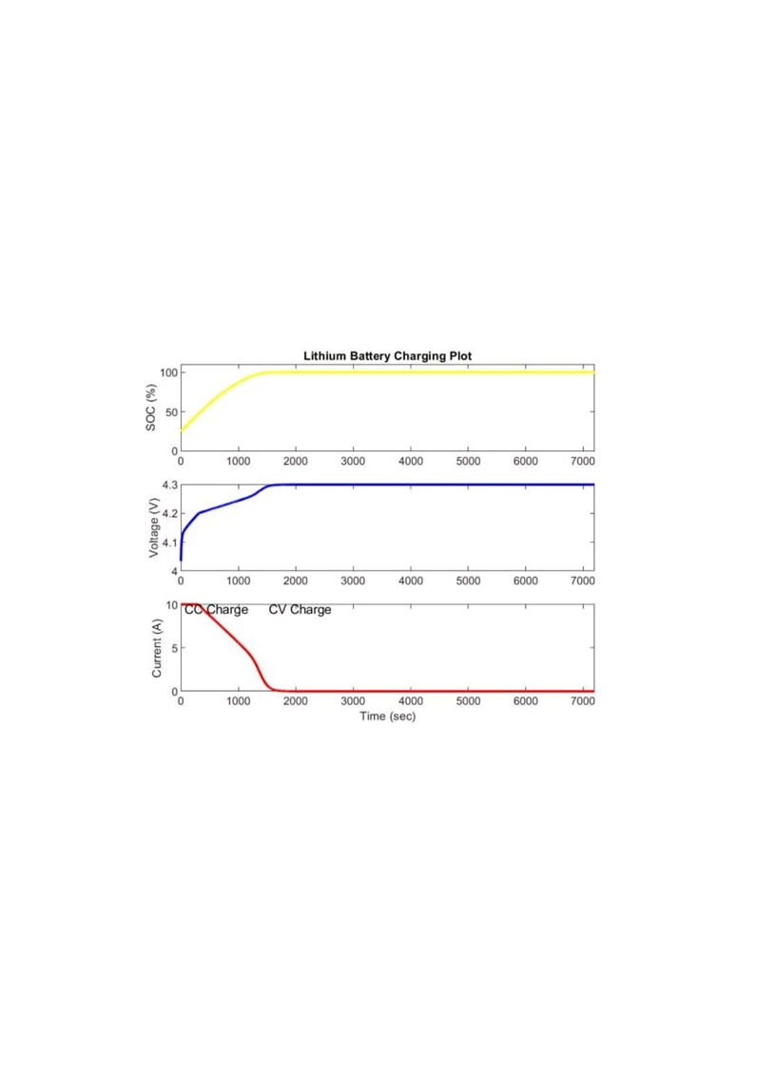
BATTERY GRAPH

Slide 11
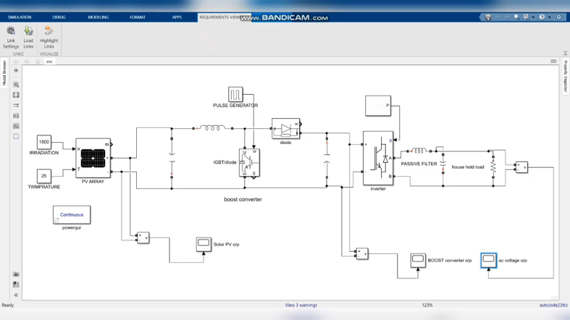
Simulation of Solar Inverter in EVs

Slide 12
STAGE-3
PV Solar Invertor Battery and Charging Station
The motivation behind this type of design is to operate EV on more efficiently in less time.
2. This type of system basically work on the separable battery which we can
directly use in EVs when it gets low from the charging station
3. In this system we can easily get charged battery from Charging station
and replace it with the low charged battery.
4. The charging is completely from the Solar Panels and when the whether is not
good we can charge batteries from the Grid Power Supply.

Slide 13
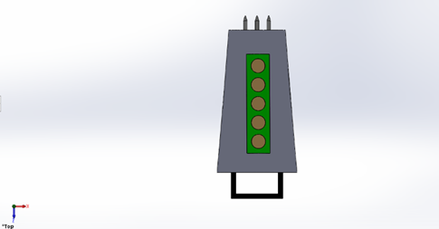
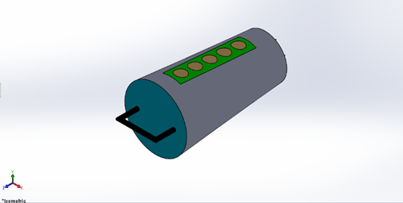
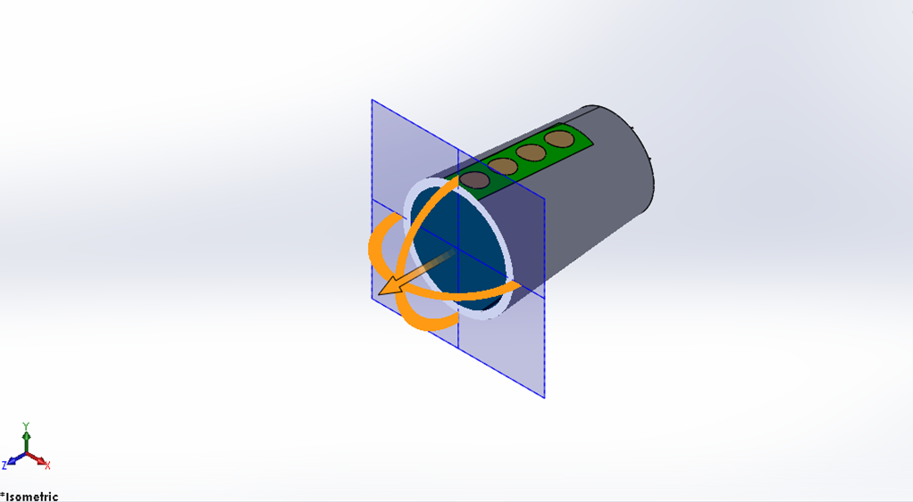
Battery Design

Slide 14
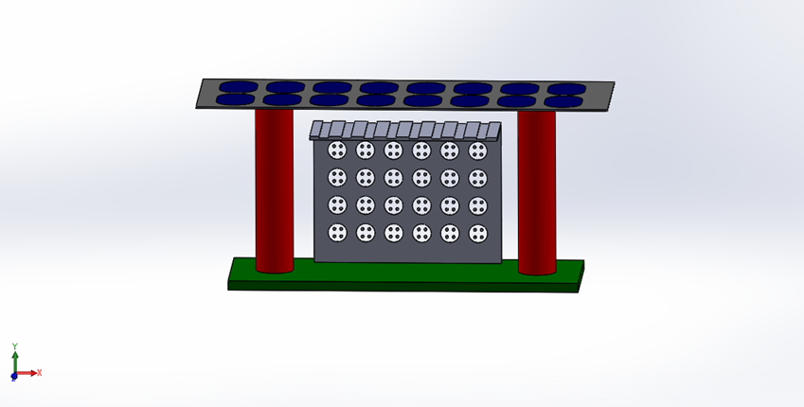
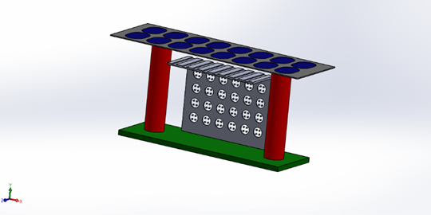
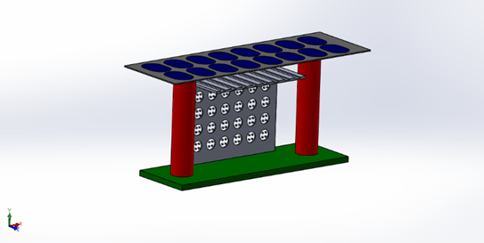
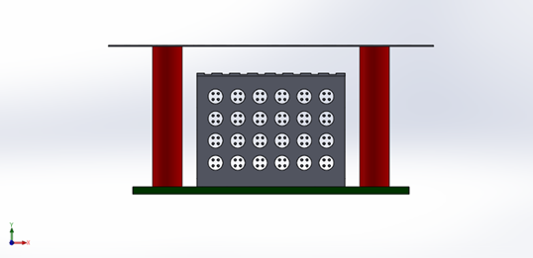
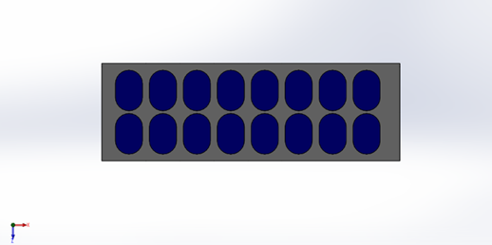
Charging Station Design

Slide 15
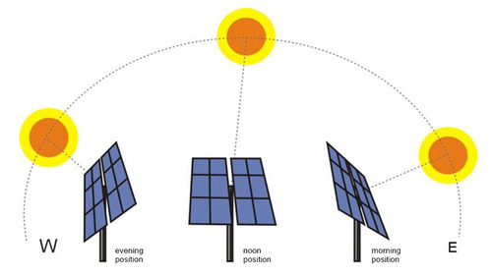
Solar Tracking of Solar Panels
Working
Here, LDR Works as a light detector. It is also known as a photoresistor. Actually, it is a light Sensitive device. As shown in the graph, the resistance decreases as light falls on it. In this project, we are using 4 LDRs to detect the Sunlight. And when they send Signal to the Arduino, It will guide two Servo Motors to better place the solar panel to maximize its efficiency.
Components Used
ARDUINO UNO R3
Micro Servo - SG90
LDR ( Photoresistor) Sensor
10k-ohm resistors
Mini Breadboard
3D body parts Design
10k Potentiometer

Slide 16
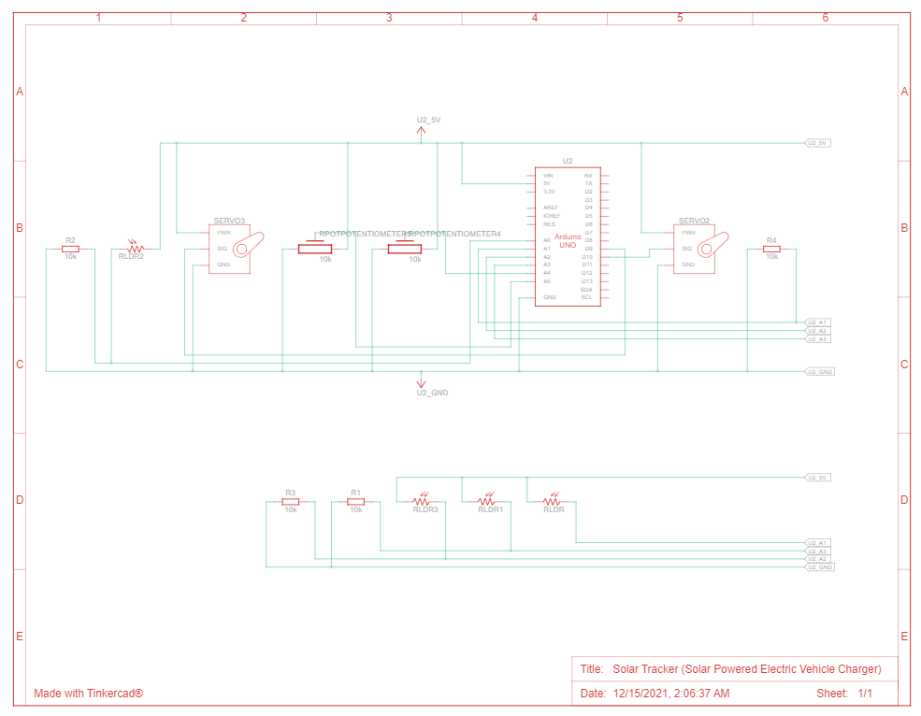
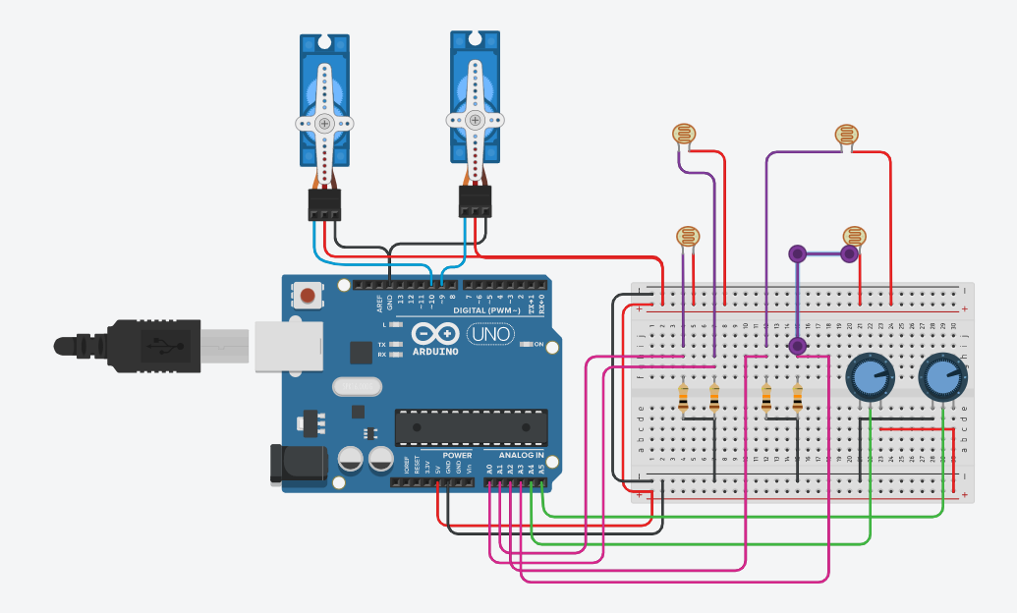
Circuit Diagram

Slide 17
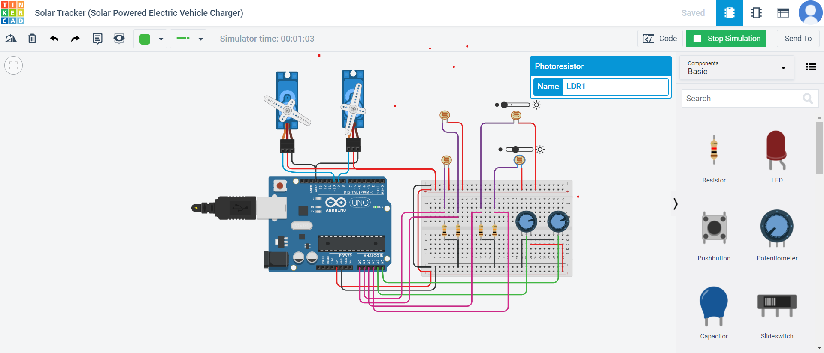
Simulation of Solar Tracker

Slide 18
Conclusion
From this project we have observed that this solar inverter is producing energy using solar energy so its eco-friendly, pollution free and its eco-friendly and it is used for the purpose of charging of batteries of Electric Vehicles in less time consumption with high rate of efficiency.
In this project we made an inverter which is sufficient to supply power to the Electric Vehicle and we have indicated on LCD display battery terminal voltage and output voltage from this observation, the user can get idea about availability of power.

Slide 19
Advantage & Disadvantages
Advantages
1. 100% Clean Energy usage for EV charging
2. Making it as a rooftop solar feeding charger can also be utilized by household when EV is not charging.
3. If designed as a charging station the station can act as mini solar plant which can provide power to grid when Evs
is not being charged.
Disadvantages
1. Whether must be clear otherwise the Solar Panel doesn’t get sun light results less and slow charging.

Slide 20
Future Scope
1. In future we can use it household usages like CNG Gas Cylinders.

Slide 21
Thanks!
Any questions?

